Slide 1
chaper 1 Objectives
To understand the nature and characteristics of databases.
To survey some important and interesting database applications.
To gain a general understanding of tables and relationships.
To describe the components of a Microsoft Access database system and explain the functions they perform.
To describe the components of enterprise-class database system and explain the functions they perform.
To define the term database management system(DBMS) and describe the functions of a DBMS.
To define the term database and describe what is contained within the database.
To define the term metadata and provide examples of metadata.
To define and understand database design from existing data.
To define and understand database design as new systems development.
To define and understand database design in database redesign.
To understand the history and development of database processing.
YOUR SITE HERE

Slide 2
Contents
1. The Characteristics of Databases
2. Database Examples
3. the Components of a Database System
4. Personal Versus Enterprise-Class Database System
5.Database Design
6.What You to Learn
7.A Brief of Database Processing
YOUR SITE HERE

Slide 3
1. The Characteristics of Databases
The purpose of a database is to help people track of things, and the most commonly used type of database is the relational database.
A relational database stores data in tables. Data are recorded facts and numbers. A table has rows and columns, like those in a spreadsheet. A database usually has multiple tables, and each table contains data about a different type of thing. For example, Figure1-1 shows a database with two tables: the Student table holds data about students, and the Class table holds data about classes.
Each row of table has data about a particular occurrence or instance of the thing of interest. For example, each row of the Student table has data one of four students: Cooke,Lau, Harris, and Greence.Similarly, each row of the Class table has data about a particular class. Because each row records the data for a specific instance, rows are also known as records. Each column of a table stores a characteristic common to all rows. For example, the first column of Student Stores StudentNumber, the second column stores LastName, and so forth.

Slide 4
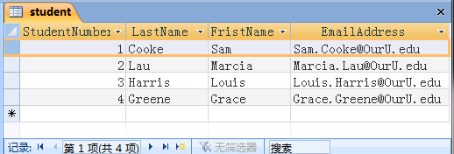
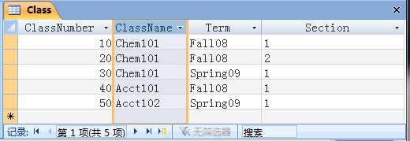
1. The Characteristics of Databases
A Note on Naming Conventions
Figure 1-1
The Student table
This row stores the data for Sam Cooke
The Class table
This column stores the ClassName for each class

Slide 5
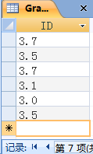
1. The Characteristics of Databases
A Database Has Data and Relationships
Figure 1-2
Figure1-1 illustrates how
database tables are structured
to store data, but a database
is not complete unless it
aslo shows the relationship
among the rows of data. To
see why this is important,
examine Figure1-2. In this
figure ,the database contains
all of the basic data shown in
Figure1-1 together with a
Grade table. Unfortunately,
the relationships between the
data are missing. A database
contains both data and the
relationships among the data.
Example:baseball scores.
The Student table
The Class table
The Grade table- but who do these grades belong to?

Slide 6
1. The Characteristics of Databases
By comparing Figure1-2 and Figure1-3, we can see how the primaty key of Student and Class were added to the Grade with a primaty key of (StudentNumber,ClassNumber) to uniquely identify each row. More important , in Grade StudentNumber and ClassNumber each now serves as a foreign key. A foreign key provides the link between two tables. By adding a foreign key, we can create a relationship between tables.
A Database Has Data and Relationships

Slide 7
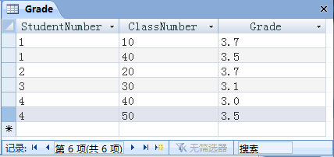
1. The Characteristics of Databases
A Database Has Data and Relationships
Figure 1-3
Figure1-3 shows the complete database
that contains not only the data about
students, classes, and grades, but also
the relationships among the rows in the
those table. For example, StudentNumber
1,who is Sam Cooke, earned a Grade of
3.7 in Class Number 10, which is
Chem101. He also earned a Grade 3.5 in
ClassNumber 40, which is Acct101.
The Student table
The Class table
Figure1-3 illustrates an important
characteristic of batabase processing.
Each row in a table is uniquely indentified
by a primary key, and the values of these
keys are used to create the relationships
between the tables. For example, in the
Student table,StudentNumber serves as
the ptimary key. Each value of
StudentNumber is unique, and uniquely
indentifies on student. Thus,
StudentNumber 1 identifies Sam Cooke.
Similarly, ClassNumber in the Class
table identifies each class.
The Grade table with foreign keys-now each grade is linked back to the Student and Class
tables

Slide 8
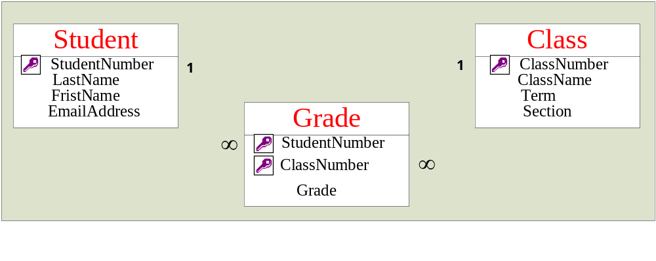
1. The Characteristics of Databases
A Database Has Data and Relationships
Figure 1-4
The Student table-the key symbol shows the primary key
The relationship between
Student and Grade—the
number 1 and the infinity
symbol indicate that one
student may be lanked to
many classes by
StudentNumber
Figure1-4 shows a Misrosoft Assecc 2007 veiw of the tables and relationship shown
in Figure 1-3. In Figure1-4, primary keys in each table are marked with key symbols,
and connecting lines representing the relationship are drawn from the foregin keys(in
Grade) to the corresponding primary keys(in Student and in Class). The symbols on
the relationship line (the number 1 and infinity symbol) mean that, for example, one
student in Student can be linked to many grades in Grade.

Slide 9
1. The Characteristics of Databases
Database Create Information
In order to make decisions, we need information upon which to base those desitions. Since we have aleady defined data as recorded facts and numbers, we can now define information as:
Knowledge derived from data.
Data presented in a meaningful context.
Data processed by summing, ordering, averaging, grouping, comparing or other similar operations.
Databases record facts and figures, so they record data. They do so, however, in a way that enables them to produce information. The data in Figure1-3 can be manipulated to produce a student’s GPA, the average GPA for a class, the average number of students
in a class, and so forth. In Chaper 2, you will be introduced to a language called Structured Quqery Language(SQL) that you can use to produce information from database data.
To summarize, relational database store data in tables, and they represent the relationships
among the rows of those tables. They do so in a way that facilitates the production of information .

Slide 10
2. Database Example
Today, database technology is part of amlost every information system. This fact
is not surprising when we consider that every information system needs to store data
and the relationship among those data. Still, the vast array of applications that use this
technology is staggering. Consider, for example, the applications listed in Figure 1-5.
Single-User Database Application
In Figure 1-5, the first applications is used by a single salesperson to keep track of
the customers she has called and the contracts that she's had with them. Most
salespeople do not build their own contract manager applications; instead, they licence
ptoducts such as GoldMine or ACT!
Multiuser Database Application
The next applications in Figure 1-5 are those that involve more than one user. The
patient-scheduling application. for example, may have 15 to 50 users. These users will
be appointment clerks, office administrators, nurses, denists, doctors, and so forth. A
database like this one may have as many as 100,000 rows of data in perhaps 5 or 10
different tables.

Slide 11
2. Database Example
When more than one user employs a database application, these is aways the chance
that one user's work may interfere with oather's. Two appointment clerks, for example,
might assign the same appointment to two different patients. Special concurrency-
control mechanisms are used to coordinate activity aginest the database to prevent
such chnflict.
The third row of Figure 1-5 shows an even larger database application. A customer
relationship management(CRM) system is an information system that manages
customer contacts from initial solictation through acceptance, purchase, continuing
purchase,support, and so forth. CRM systems are used by salespeople, sales managers,
customer service and support staff, and other personal. A CRM database in a larger
company might have 500 users and 10 million or more rows in perhaps 50 or more
tables. According to Microsoft, in 2004 Verizon had an SQL Server customer database
that containal more than 15 terabytes of data. If that data were published in books, a
bookshelf 450 miles long would be required to hold them.

Slide 12
2. Database Example
Applicasion | Example Users | Numbers of Users | Typical Size | Remarks
Sales contact manager | Salesperson | 1 | 2,000 rows | Products such as GoldMine and Act! are database centric
Patient appointment (doctor, dentist) | Medical office | 15 to 50 | 100,000 rows | Vertical market software vendors in corporate database into their software products.
Customer Relationship Management(CRM) | Sales, marketing, or customer service departments | 500 | 10 million rows | Major vendors such as Siebel and PeopleSoft build applications around for database
Enterprise Resource Planning(ERP) | An entire orginization | 5,000 | 10 million +rows | SAP uses a database as a central repository for ERP data.
E-commerce site | Internet users | Possibly millions | 1 billion +rows | Drugstore.com has a database that grows at the rate of 20 million rows per day!
Digital dashboard | Senior managers | 500 | 100,000 rows | Extractions,summaries, and consolidations of operational database.
Data mining | Business analysts | 25 | 100,000 to million + | Data are extracted, reformatted, cleaned, and filtered for use by statistical data mining tools.
Figure 1-5

Slide 13
2. Database Example
Reporting and Data Mining Database Applications
Two other example applications in Figure 1-5 are digital dashboards and data mining applications.
These applications use the data generated by order processing and other operational systems to produce
information to help manage the enterprise. Such applications do not generate new data, but instead
summarize existing data to provide insights to management. Digital dashboards and other reporting
systems assess past and current performance. Data mining applications predict future performance. We
will consider such applications in Chapter 15. The bottom line is that database technology is used in
almost every information system and involves databases ranging in size from a few thousand rows
to many millions of rows.
By the way Do not assume that just because a database is small that its structure
is simple. For example, consider parts distribution for a company that sells $1 million
in parts per year and parts distribution for a company that sells $100 million in parts
per year. Despite the difference in sales, the companies have similar databases. Both
have the same kinds of data, about the same number of tables of data, and the same
level of complexity in data relationships. Only the amount of data varies from one to
the other. Thus, although a database for a small business may be small, it is not
necessarily simple

Slide 14
2. Database Example
Enterprise resource planning(ERP) is an information system that touches every department in a
manufacturing company. It includes sales, production planning, purchasing, and other business
functions. SAP is the leading vendor of ERP applications, and a key element of its product is a
database that integrates data from these various business functions. An ERP system may have 5,000
or more users and perhaps 100 million rows in several hundred tables.
E-Commerce Database Applications
E-commerce is another important database application. Databases are a key component of e
commerce order entry, billing, shipping, and customer support. Surprisingly, however, the largest
databases at an e-commerce site are not order-processing databases. The largest databases are those
that track customer browser behavior. Most of the prominent e-commerce companies, such as
Amazon.com (www.amazon.com) and Drugstore.com(www.drugstore.com) keep track of the Web
pages and the Web page components that they send to their customers. They also track customer
clicks, additions to shopping carts, order purchases, abandoned shopping carts, and so forth. E
commerce companies use Web activity databases to determine which items on a Web page are
popular and successful and which are not. They also can conduct experiments to determine if a
purple background generates more orders than a blue one, and so forth. Such Web usage data-bases
are huge. For example, Drugstore.com adds 20 million rows to its Web log database each day!

Slide 15
3.The Components of a Database System
As shown in Figure 1-6, a database system is typically defined to consist of four components: users, the database
application, the database management system (DBMS), and the database. However, given the importance of
Structured Query Language (SQL), an internationally recognized standard language that is understood by all
commercial DBMS products, in database processing and the fact that database applications typically send SQL
statements to the DBMS for processing, we can refine our illustration of a database system to appear as shown in
Figure 1-7.
Starting from the right of Figure 1-7, the database is a collection of related tables and other structures. The
database management system (DBMS) is a computer program used to create, process, and administer the
database.The DBMS receives requests encoded in SQL and translates those requests into actions on the database.
The DBMS is a large, complicated program that is licensed from a software vendor; companies almost never write
their own DBMS programs.
A database application is a set of one or more computer programs that serves as an intermediary between the
user and the DBMS. Application programs read or modify database data by sending SQL statements to the
DBMS. Application programs also present data to users in the format of forms and reports. Application programs
can be acquired from software vendors, and they are also frequently written in-house. The knowledge you gain
from this text will help you write database applications.
Users, the fourth component of a database system, employ a database application to keep track of things.
They use forms to read, enter, and query data, and they produce reports to convey information.

Slide 16
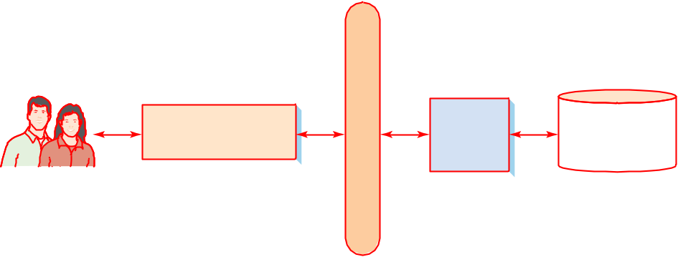
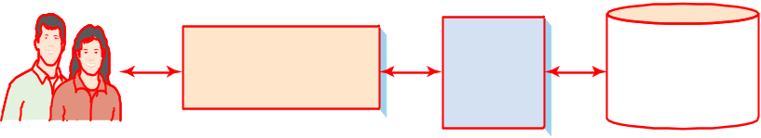
3.The Components of a Database System
Figure 1-6
Figure 1-7
The Components of a Database System
The Components of a
Database Systems with SQL
Database
appalication
DBMS
Database
S
Q
L
Database
appalication
DBMS
Database
Users
•Create
•Proces
•Administer
Users
•Create
•Proces
•Administer
YOUR SITE HERE

Slide 17
3.The Components of a Database System
Database Applications and SQL
Figure 1-7 shows the database applications that users interact with directly. Figure 1-8 lists the
basic functions of database applications.
First, an application program creates and processes forms. Figure 1-9 shows a typical form for
entering and processing student enrollment data for the Student-Class-Grade database shown in
Figures 1-3 and 1-4. Notice that this form hides the structure of the underlying tables from the
user. By comparing the tables and data in Figures 1-3 and 1-4 to the form in Figure 1-9, we can
see that data from the CLASS table appears at the top of the form, while data from the STUDENT
table is presented in a tabular section labeled Class Enrollment Data.
The goal of this form, like that for all data entry forms, is to present the data in a format that is
useful for the users, regardless of the underlying table structure. Behind the form, the application
processes the database in accordance with the users’ actions. The application generates an SQL
statement to insert, update, or delete data for any of the tables that underlie this form.
The second function of application programs is to process user queries. The application
program first generates a query request and sends it to the DBMS. Results are then formatted and
returned to the user. Applications use SQL statements and pass them to the DBMS for processing.
To give you a taste of SQL, here is a sample SQL statement for processing the STUDENT table in
Figure 1-1:
SELECT LastName, FirstName, EmailAddress
FROM STUDENT
WHERE StudentNumber > 2;
Figure 1-8

Slide 18
3.The Components of a Database System
Database Applications and SQL
Figure 1-8
Basic Functions of
Application Programs
• Create and process forms
• Process user queries
• Create and process reports
• Execute application logic
• Control application

Slide 19
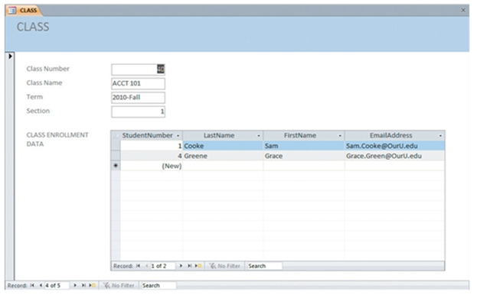
3.The Components of a Database System
Database Applications and SQL
Figure 1-9
An Example Data Entry Form

Slide 20
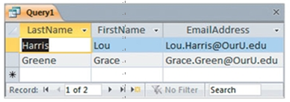
3.The Components of a Database System
Database Applications and SQL
This SQL statement is a query statement, which asks the DBMS to obtain specific data
from a database. In this case, the query asks for the last name, first name, and e-mail
address of all students having a StudentNumber greater than 2. The results of this
SQL statement are shown (as displayed in Microsoft Access 2010) in Figure 1-10. As
shown in Figure 1-10, running this SQL statement will produce the LastName,
FirstName, and EmailAddress for students Harris and Greene.
Figure 1-10
Example SQL
Query Results

Slide 21
3.The Components of a Database System
Database Applications and SQL
The third function of an application is to create and process reports. This function is somewhat
similar to the second because the application program first queries the DBMS for data (again
using SQL). The application then formats the query results as a report. Figure 1-11 shows a report
that displays all the Student-Class-Grade data shown in Figure 1-3 sorted by ClassNumber and
LastName. Notice that the report, like the form in Figure 1-9, is structured according to the users’
needs, not according to the underlying table structure.
In addition to generating forms, queries, and reports, the application program takes other
actions to update the database in accordance with application-specific logic. For example,
suppose a user using an order entry application requests 10 units of a particular item. Suppose
further that when the application program queries the database (via the DBMS), it finds that
only 8 units are in stock. What should happen? It depends on the logic of that particular appli-
cation. Perhaps no units should be removed from inventory, and the user should be notified, or
perhaps the 8 units should be removed and 2 more placed on back order. Perhaps some other
action should be taken. Whatever the case, it is the job of the application program to execute
the appropriate logic.

Slide 22
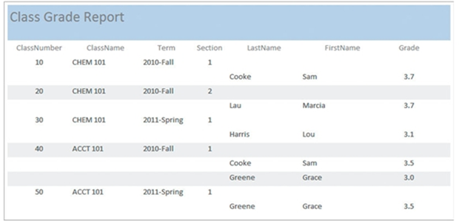
3.The Components of a Database System
Database Applications and SQL
Finally, the last function for application programs listed in Figure 1-8 is to control the application.
This is done in two ways. First, the application needs to be written so that only logical options are
presented to the user. For example, the application may generate a menu with user choices. In this
case, the application needs to ensure that only appropriate choices are available. Second, the
application needs to control data activities with the DBMS. The application might direct the
DBMS, for example, to make a certain set of data changes as a unit. The application might tell the
DBMS to either make all these changes or none of them.
Figure 1-11
Example Report

Slide 23
3.The Components of a Database System
The DBMS
The DBMS, or database management system, creates, processes, and administers the database. A
DBMS is a large, complicated product that is almost always licensed from a software vendor. One
DBMS product is Microsoft Access. Other commercial DBMS products are Oracle Database and
MySQL, both from Oracle Corporation; SQL Server, from Microsoft; and DB2, from IBM.
Dozens of other DBMS products exist, but these five have the lion’s share of the market. Figure 1
12 lists the functions of a DBMS.
A DBMS is used to create a database and to create the tables and other supporting structures
inside that database. As an example of the latter, suppose that we have an EMPLOYEE table with
10,000 rows and that this table includes a column, DepartmentName, that records the name of the
department in which an employee works. Furthermore, suppose that we frequently need to access
employee data by DepartmentName. Because this is a large database, searching through the table
to find, for example, all employees in the accounting department would take a long time. To
improve performance, we can create an index (akin to the index at the back of a book) for
DepartmentName to show which employees are in which departments. Such an index is an
example of a supporting structure that is created and main-tained by a DBMS.
The next two functions of a DBMS are to read and modify database data. To do this, a DBMS
receives SQL and other requests and transforms those requests into actions on the database files.
Another DBMS function is to maintain all the database structures. For example, from time to time
it might be necessary to change the format of a table or another supporting structure. Developers
use a DBMS to make such changes.

Slide 24
3.The Components of a Database System
The DBMS
Figure 1-12
Functions of a DBMS
• Create database
• Create tables
• Create supporting structures (e.g., indexes) • Read database data
• Modify (insert, update, or delete) database data • Maintain database structures
• Enforce rules
• Control concurrency
• Provide security
• Perform backup and recovery

Slide 25
3.The Components of a Database System
The DBMS
With most DBMS products, it is possible to declare rules about data values and have a DBMS
enforce them. For example, in the Student-Class-Grade database tables in Figure 1-3, what would
happen if a user mistakenly entered a value of 9 for StudentNumber in the GRADE table? No such
student exists, so such a value would cause numerous errors. To prevent this situation, it is possible to
tell the DBMS that any value of StudentNumber in the GRADE table must already be a value of
StudentNumber in the STUDENT table. If no such value exists, the insert or update request should be
disallowed. The DBMS then enforces these rules, which are called referential integrity constraints.
The last three functions of a DBMS listed in Figure 1-12 have to do with database administration.
A DBMS controls concurrency by ensuring that one user’s work does not inappropriately interfere
with another user’s work. This important (and complicated) function is discussed in Chapter 9. Also,
a DBMS contains a security system that ensures that only authorized users perform authorized actions
on the database. For example, users can be prevented from seeing certain data. Similarly, users’
actions can be confined to making only certain types of data changes on specified data.
Finally, a DBMS provides facilities for backing up database data and recovering it from
backups, when necessary. The database, as a centralized repository of data, is a valuable organizational
asset. Consider, for example, the value of a book database to a company such asAmazon.com. Because
the database is so important, steps need to be taken to ensure that no data will be lost in the event of
errors, hardware or software problems, or natural or human catastrophes.

Slide 26
3.The Components of a Database System
The Database
The last component in Figure 1-7 is the database. A database is a self-describing collection of
integrated tables. Integrated tables are tables that store both data and the relationships among the
data. The tables in Figure 1-3 are integrated because they store not just student, class, and grade
data, but also data about the relationships among the rows of data.
A database is self-describing because it contains a description of itself. Thus, databases
contain not only tables of user data, but also tables of data that describe that user data. Such
descriptive data is called metadata because it is data about data. The form and format of metadata
varies from DBMS to DBMS. Figure 1-13 shows generic metadata tables that describe the tables
and columns for the database in Figure 1-3.
You can examine metadata to determine if particular tables, columns, indexes, or other
structures exist in a database. For example, the following statement queries the Microsoft SQL
Server metadata table SYSOBJECTS to determine if a user table (Type = ‘U’) named CLASS
exists in the database. If it does, the table is dropped (removed) from the database.
IF EXISTS
(SELECT *
FROM SYSOBJECTS
WHERE [Name]='CLASS‘
AND Type='U')
DROP TABLE CLASS;
Do not be concerned with the syntax of this statement. You will learn what it means and how to write such statements yourself as we proceed. For now, just understand that this is one way that database administrators use metadata.

Slide 27
3.The Components of a Database System
The Database
Figure 1-13
ColumnName | TableName | DataType | Length(bytes)
StudentNumber | STUDENT | Integer | 4
Lastname | STUDENT | Text | 25
Firstname | STUDENT | Text | 25
EmailAddress | STUDENT | Text | 100
ClassNumber | CLASS | Integer | 4
Name | CLASS | Text | 25
Term | CLASS | Text | 12
Section | CLASS | Integer | 4
StudentNumber | GRADE | Integer | 4
ClassNumber | GRADE | Integer | 4
Grade | GRADE | Decimal | (2, 1)
Typical Metadata Tables
USER_TABLES Table
TableName | NumberColumns | PrimaryKey
STUDENT | 4 | StudentNumber
CLASS | 4 | ClassNumber
GRADE | 3 | (StudentNumber, ClassNumber)
USER_COLUMNS Table

Slide 28
3.The Components of a Database System
The Database
Figure 1-14
Database Contents
Discussed in
Chapters 7, 10, 10A,
10B
• Tables of user data
• Metadata
• Indexes
• Stored procedures
• Triggers
• Security data
• Backup/recovery data
Discussed in
Chapters 9, 10, 10A, 10B

Slide 29

3.The Components of a Database System
The Database
In addition to user tables and metadata, databases contain other elements, as shown in Figure 1-14.
These other components will be described in detail in subsequent chapters. For now, however,
understand that indexes are structures that speed the sorting and searching of database data. Triggers
and stored procedures are programs that are stored within the database. Triggers are used to maintain
database accuracy and consistency and to enforce data constraints. Stored procedures are used for
database administration tasks and are sometimes part of database applications. You will learn more
about these different elements in Chapters 7, 10, 10A, and 10B.
Security data define users, groups, and allowed permissions for users and groups. The particulars
depend on the DBMS product in use. Finally, backup and recovery data are used to save database data
to backup devices as well as to recover the database data when needed. You will learn more about
security and backup and recovery data in Chapters 9, 10, 10A, and 10B.
By the way Because metadata is stored in tables, you can use SQL to query it, as just illustrated. Thus, by learning how to write SQL to query user tables, you will
also learn how to write SQL to query metadata. To do that, you just apply the SQL statements to metadata tables rather than user tables.

Slide 30
Thank You!
LOGO

